Slide 1
Predicting New York Neighborhood median rent

Slide 2
Introduction
Living quality in a New York neighborhood may be determined by the presence of nearby restaurants, park, supermarkets and etc
Renter may want to know what places increase the rent
The real estate owner may want to know whether the quality of neighborhoods supports the rent price.

Slide 3
Data acquisition and cleaning
The median rent data of New York is extracted from this website https://streeteasy.com/blog/data-dashboard/.
the numbers of venues near each neighborhood are extracted from Foursqare API (https://foursquare.com/)
Average of the last 12 months median rent was used
Include the venues within a radius of 500 meters

Slide 4
The venues available in the neighborhoods with the highest rent and lowest rent
Table 1. Comparison of number of venues in the most expensive and cheapest neighborhoods
 | Central Park South(median rent: $7481) | Van Nest ($1481)
1 | Hotel(13) | Deli/Bodega(7)
2 | Boutique(7) | Pizza Place(5)
3 | Jewelry Store(6) | Bus Station (2)
4 | American Restaurant(5) | Liquor Store(1)
5 | Italian Restaurant(5) | Chinese Restaurant(1)

Slide 5
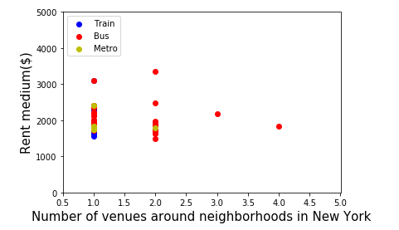
The number of transportation station avaliable vs the rent median
Rent median($)

Slide 6
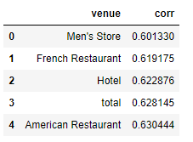
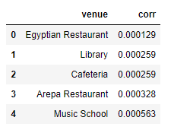
The venues with the highest and lowest correlation with the rent median

Slide 7
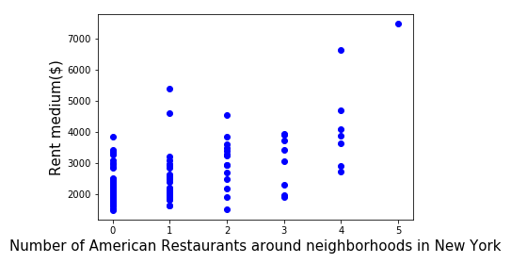
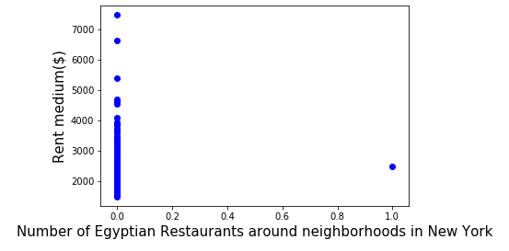
The scatter plots of number of American restaurants and Egyptian restaurants vs the rent median

Slide 8
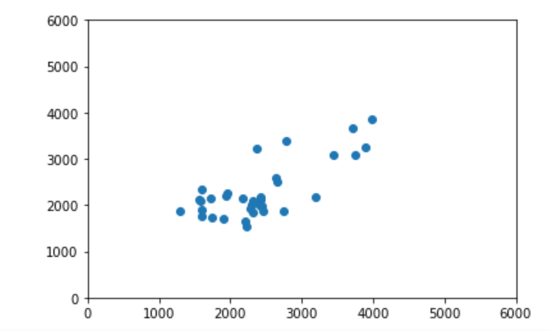
The true median rent vs the predicted rent
true median rent($)
$444 average error
0.33 variance explained
predicted median rent($)

Slide 9
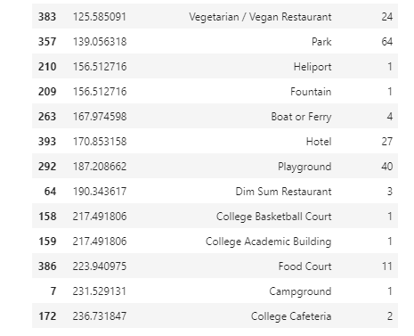
A glance on what contribute to the median price most
US dollars/occurance
Venue
Occurrence in total
Every college Cafeteria can increase the median rent by $236

Slide 10
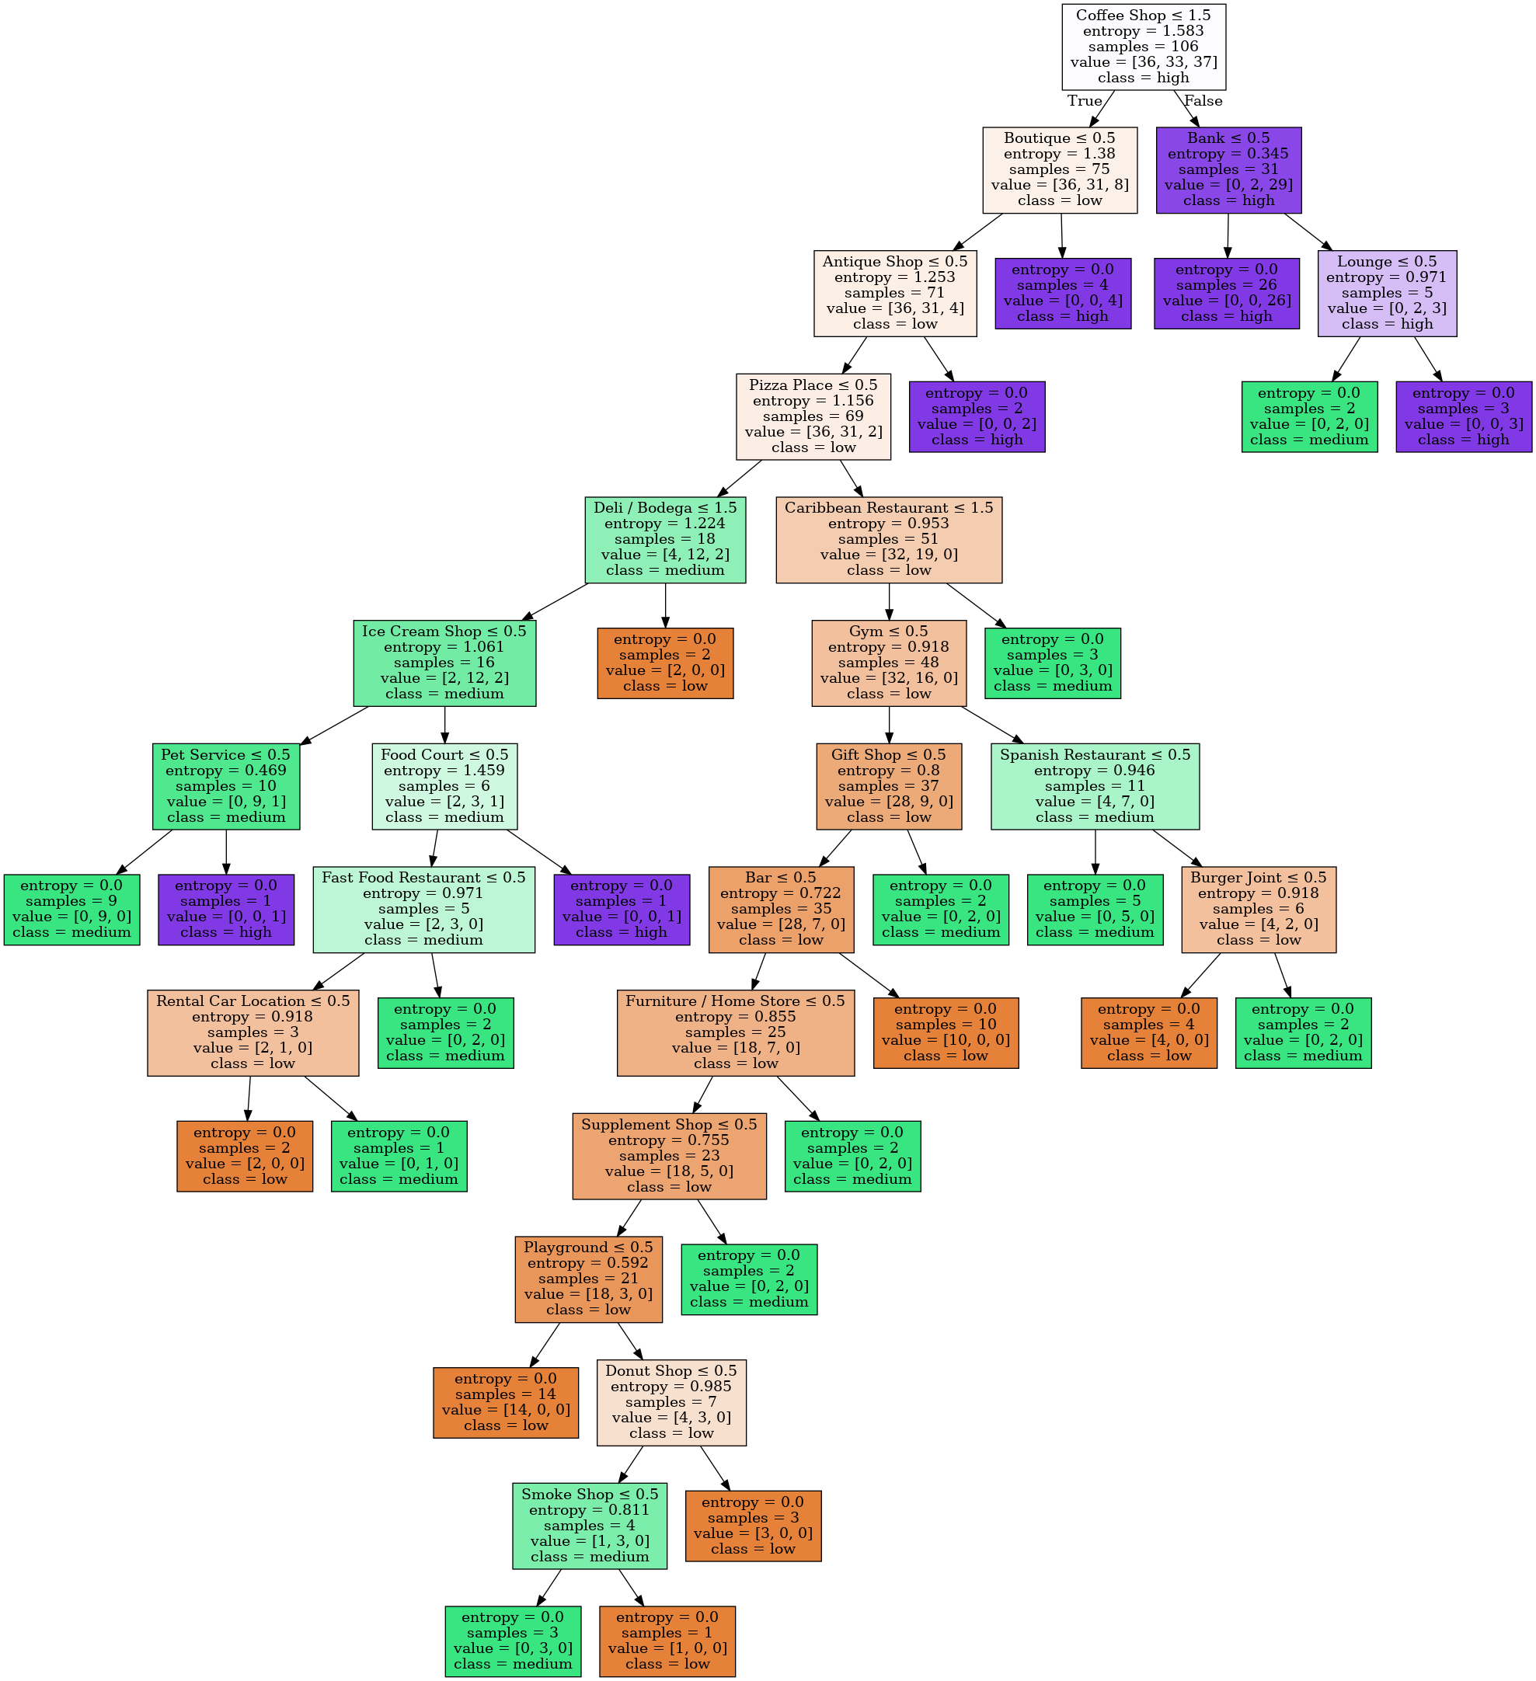
Decision tree (0.62 accuracy)
Let us try decision tree. It is not better than the multiple linear regression

Slide 11
Decision tree (0.62 accuracy)

Slide 12
Conclusion and future directions
It is feasible to predict the meidan rent of New York neighborhoods with reasonable accuracy by using multiple linear regression.
Decision Tree is not a good idea.
Future work could focus on increasing training set size and number of variables

